Slide 1


Lecture 3:
Data Preprocessing
and Intro To ML Models
McGill Artificial
Intelligence Society

Slide 2
Today’s Agenda
Machine Learning Pipeline (Cont’d)
Data Preprocessing
Evaluation Metrics
Introduction to Basic ML Models and Scikit-Learn

Slide 3
Machine Learning Pipeline
1 Identify Problem
Carefully define the problem you want to solve. What specific question are you trying to answer?
2 Gather Data
Figure out what data is needed and where to retrieve it. Does similar data exist or do we need to generate it?
3 Process Data
Format data that can be interpreted by a computer. That includes cleaning, manipulating and extracting important features to feed into the training model.
4 Train Model
Training the dataset on your selected model. In practice, datasets are split into train, validation and test sets in order to measure model performance.
5 Evaluate Results
Does the trained model solve your initial problem? Does it satisfy your performance requirements?
6 Repeat!
Improve your model by reiterating the process!

Slide 4
Before Fitting the Model
Constructed Features
Feature
Subset
Preprocessing/
Feature Construction
Feature Selection
ML Model/
Predictor
Raw features
Raw features may include missing values, useless data, class imbalance, etc.
Preprocessing / Feature construction: build intermediate features from the original ones in the dataset with the goal of building more efficient features for the machine learning task.
example: year of birth → (current year - year of birth) → age
Feature selection: choosing the useful subset of feather to feed into your model
(not all features are useful, and some of them might only be noisy for your model!)
Notes:
So when tackling machine learning problems, when you’re looking for your own data, or even when you’re given a dataset, if the dataset hasn’t been worked on, you get what’s called “raw features”. This includes missing values, useless features and all.
After running these raw features through data preprocessing, we get what we call constructed features. These are your intermediate features obtained, but they don’t necessarily all get chosen to be fed into your ML model. So we have to go through feature selection, which is simply choosing a subset of features to feed into your ML model. With all that being said, what do we hope to accomplish? (slide)

Slide 5
Goal of preprocessing
Improve overall model performance
Reduce noise by removing unnecessary / noisy data
Improve interpretability
Reduce memory / time loads
Can save significant compute time / resources
Very crucial in machine learning (especially deep learning)
Notes:
Essentially, we want to do 3 things. The first, most obvious one, is to improve the overall model performance! This is done by making the data more “interpretable” to the machine. Second of all, if we reduce the feature space by getting rid of unimportant features, we don’t have to process on as much data, and this would save us both time, and memory, which in machine learning, is huge.
(Ask audience questions)
So now, we’ll go over a practical example of data preprocessing (Slide)

Slide 6
Data Preprocessing
Techniques

Slide 7
Missing data (NaN)
Ignore the data row
Imputation
For numerical values:
Replace with median or mean of the attribute
For categorical values:
Replace with majority class
Use regression / machine learning models to predict what the missing values may be
Problem with imputation:
Bias the dataset (the data may not be correct)
Notes:
Imputation: replace missing values with substitutional values
Mean vs. Median: both have pros and cons. Generally is the reduce of some variability of the data. (if all becomes the average, then you’re reducing the variance)
Machine learning models: regression, inference based tools using Bayesian formalism, decision trees, clustering algorithms (K-Mean\Median etc.).

Slide 8
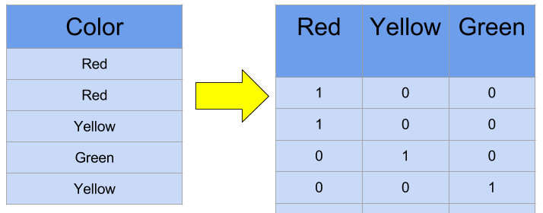
One-Hot Encoding
Converts categorical data into a form that your computer / algorithm can understand.
Notes:
The input if converted to a vector where the corresponding class is 1 and the rest is 0.
It is to binarize the categories.
This may become a problem when the number of classes increases, and the memory and compute time increases exponentially
Talk about Label encoding where you assign a numerical value to each class, but that creates a problem because the classes don’t actually have any relations, but the machine may learn the 0 < 1 < 2 < 3 … relationship between the classes and the outputs (which is wrong)

Slide 9
Data Normalization
Make the attributes fall between 0 and 1.
Why?
Puts all the inputs on the same scale [0, 1] to avoid problems created by large ranges
Normalization maintains general distribution and ratios of the dataset
All this can be done using Pandas

Slide 10
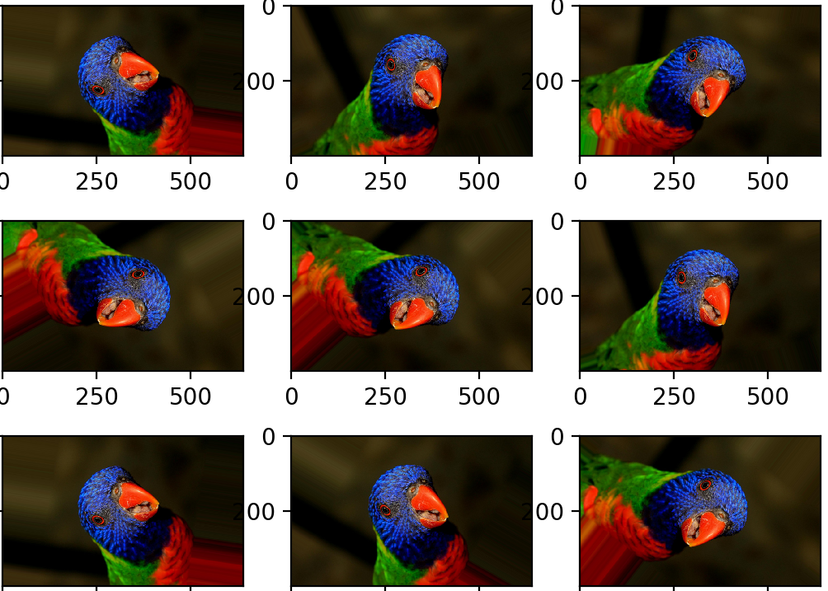
Data Augmentation
Performing linear transformation on existing data to strategically generate more data for training.
Especially used in computer vision and Deep Learning (you’ll learn more about this later!) where models need a large amount of data to train.
Photos by Jason Brownlee

Slide 11
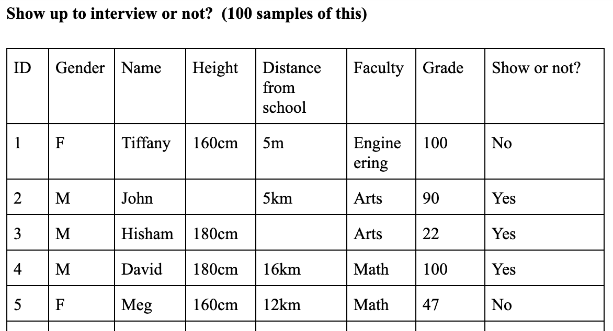
Study the data and remove the unnecessary columns

Slide 12

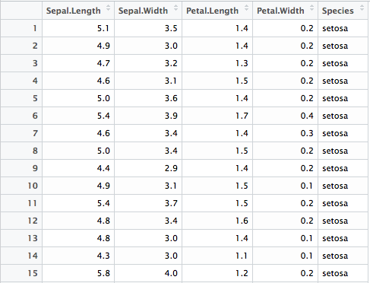
Train-Test Split
TRAIN
TEST
Notes:
When we are given a dataset, we don’t want to train on the entirety of the dataset, otherwise, there will be no way for us to measure how good our model does when given new data. So typically, what we would do is to set aside a portion of our dataset (a good number is approximately 25%), this is called the test set, whereas the other 75% of the data is called the training set. After our model is done training on the training set, we will then test the model on the test set, using various metrics to gauge its performance

Slide 13
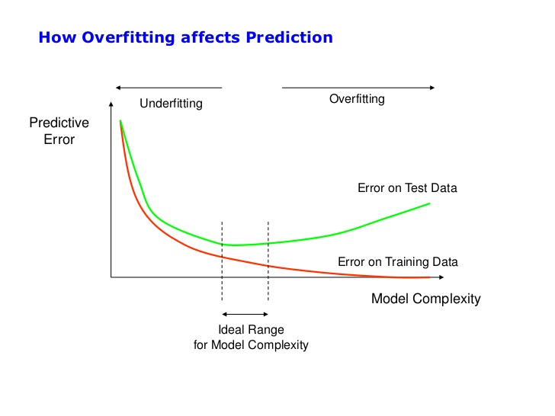
Overfitting vs Underfitting
PIcture from Stack Exchange Cross Validated
Notes:
One of the big reasons we do a train-test-split is to tackle the overfitting and underfitting problem. When we are training a model, what we essentially want to do is to have a model be able to reflect what happens in reality. However, the data that we get in reality typically contains a lot of noise, making it difficult to have a model to exactly predict the “correct” answer. When we underfit a model, it means our model isn’t complex enough, or hasn’t trained enough to learn the intricacies of what happens in reality, and is reflected by a high error in both the training set and test set. When we overfit a model, the model not only learns the trends that happen in reality, but also learns the noise in the environment, which is something we don’t want as the noise is generally randomized and provides no real insight for the inferences we are trying to make. An overfit model will typically have very low training set error but high test set error.
Note: talk about machine learning model terminology, call it a “prediction model”
Gathering data: a lot of open-source repos exist, e.g. Kaggle and UCI
Processing data: a lot of data is bad, missing, or uninterpretable by ML models, we need to process this data to improve performance
This also involves splitting your data into train/test splits. That is, for every machine learnin

Slide 14
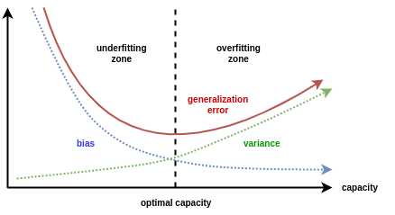
Variance vs. Bias
Image from Minds, Brains, and Programs - Wordpress

Slide 15
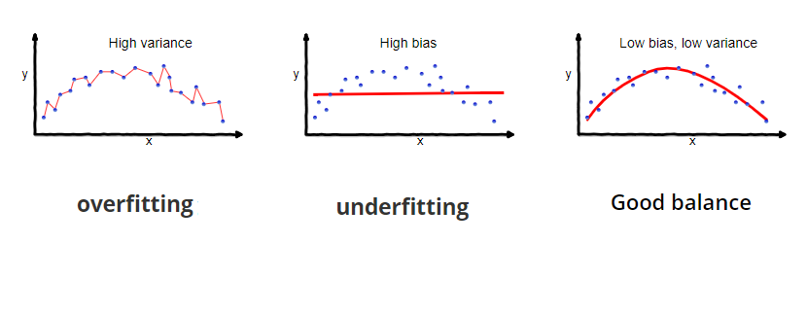
Variance vs. Bias
Image from Towards Data Science

Slide 16
Machine Learning Pipeline
1 Identify Problem
Carefully define the problem you want to solve. What specific question are you trying to answer?
2 Gather Data
Figure out what data is needed and where to retrieve it. Does similar data exist or do we need to generate it?
3 Process Data
Format data that can be interpreted by a computer. That includes cleaning, manipulating and extracting important features to feed into the training model.
4 Train Model
Training the dataset on your selected model. In practice, datasets are split into train, validation and test sets in order to measure model performance.
5 Evaluate Results
Does the trained model solve your initial problem? Does it satisfy your performance requirements?
6 Repeat!
Improve your model by reiterating the process!

Slide 17
What Is A Model?
Input
x
MODEL
f(x)
Output
y
Your model is a function that is:
Trained using and tailored to a dataset
Best optimized to give an accurate output based on your input

Slide 18

Choosing an Algorithm

Slide 19
Hyperparameter vs Weights
Hyperparameters:
Parameter whose value is set before the learning begins.
Chosen by the human
eg: number of epochs, batch size, learning rate, etc.
Weights:
Parameters that are learned by the ML model / algorithm.
They are used to make predictions.
Goal: Make your model learn the weights that best generalize the problem given the training set.
→ The weights that make the best predictions.

Slide 20
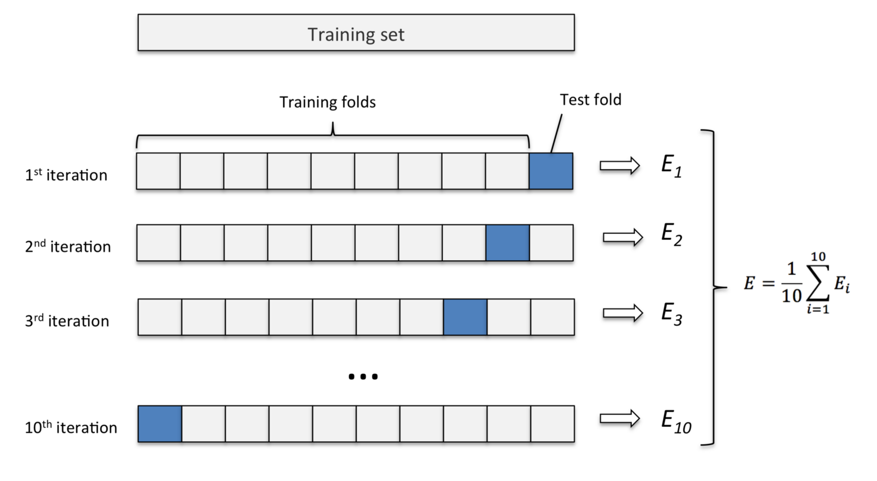
K-Fold Cross Validation
Notes:
With a single train-test split, even if you randomize your data, you might get a biased/ imbalanced distribution on your test set, causing your measured test error to have high variance. That is, depending on your test set, empirically your error might be inconsistent on different test sets. In order to reduce this variance, we use a technique called k cross-fold validation to train the model’s parameters.
Split into k folds, train on k-1, test on kth fold.
Average parameters learned over k folds
Reduces variance, slight trade-off since we “waste 1/K” amount of data per iteration. Also K times more expensive to compute.

Slide 21
Today we will explore how different preprocessing techniques change the result on the same model.
The rest of this course will be focused on learning the differences about each model and how to choose the right one.

Slide 22
Machine Learning Pipeline
1 Identify Problem
Carefully define the problem you want to solve. What specific question are you trying to answer?
2 Gather Data
Figure out what data is needed and where to retrieve it. Does similar data exist or do we need to generate it?
3 Process Data
Format data that can be interpreted by a computer. That includes cleaning, manipulating and extracting important features to feed into the training model.
4 Train Model
Training the dataset on your selected model. In practice, datasets are split into train, validation and test sets in order to measure model performance.
5 Evaluate Results
Does the trained model solve your initial problem? Does it satisfy your performance requirements?
6 Repeat!
Improve your model by reiterating the process!

Slide 23
Overfitting vs Underfitting
https://www.google.ca/url?sa=i&rct=j&q=&esrc=s&source=images&cd=&cad=rja&uact=8&ved=2ahUKEwjP3cC_-73dAhXq8YMKHbCjDhUQjRx6BAgBEAU&url=https%3A%2F%2Fstats.stackexchange.com%2Fquestions%2F292283%2Fgeneral-question-regarding-over-fitting-vs-complexity-of-models&psig=AOvVaw2w0fUI83QmZj2Wm8HNcyXd&ust=1537133719302285
Notes:
One of the big reasons we do a train-test-split is to tackle the overfitting and underfitting problem. When we are training a model, what we essentially want to do is to have a model be able to reflect what happens in reality. However, the data that we get in reality typically contains a lot of noise, making it difficult to have a model to exactly predict the “correct” answer. When we underfit a model, it means our model isn’t complex enough, or hasn’t trained enough to learn the intricacies of what happens in reality, and is reflected by a high error in both the training set and test set. When we overfit a model, the model not only learns the trends that happen in reality, but also learns the noise in the environment, which is something we don’t want as the noise is generally randomized and provides no real insight for the inferences we are trying to make. An overfit model will typically have very low training set error but high test set error.
Note: talk about machine learning model terminology, call it a “prediction model”
Gathering data: a lot of open-source repos exist, e.g. Kaggle and UCI
Processing data: a lot of data is bad, missing, or uninterpretable by ML models, we need to process this data to improve performance
This also involves splitting your data into train/test splits. That is, for every machine learnin

Slide 24


Metrics to Evaluate Your Model
Classification:
Confusion Matrix:
 | Predicted: YES | Predicted: NO
Actual: YES | TP | FN
Actual: NO | FP | TN

Slide 25


Metrics to Evaluate Your Model
Regression models

Slide 26
Machine Learning Pipeline
1 Identify Problem
Carefully define the problem you want to solve. What specific question are you trying to answer?
2 Gather Data
Figure out what data is needed and where to retrieve it. Does similar data exist or do we need to generate it?
3 Process Data
Format data that can be interpreted by a computer. That includes cleaning, manipulating and extracting important features to feed into the training model.
4 Train Model
Training the dataset on your selected model. In practice, datasets are split into train, validation and test sets in order to measure model performance.
5 Evaluate Results
Does the trained model solve your initial problem? Does it satisfy your performance requirements?
6 Repeat!
Improve your model by reiterating the process!

Slide 27
Scikit-Learn

Slide 28

What is Scikit-Learn
Open Source tool for simple and efficient data analysis
Built on NumPy, SciPy and Matplotlib
Easy use of simple machine learning algorithms
Well documented and explained ML algorithm API
Notes:
Switch to Jupyter Notebook

Slide 29
Homework Assignment
Practice data preprocessing.
Assignment3-DataPreprocessing.ipynb

Slide 30
Thanks!
Any questions?
McGill Artificial
Intelligence Society

